Slide 1

Hazardous Air Pollutants in USA from 1990 to 2017 Analysis
Group 6
Krishna Ghorpade
Songyun Qian
Himani Patel
Shahnawaz Khan

Slide 2
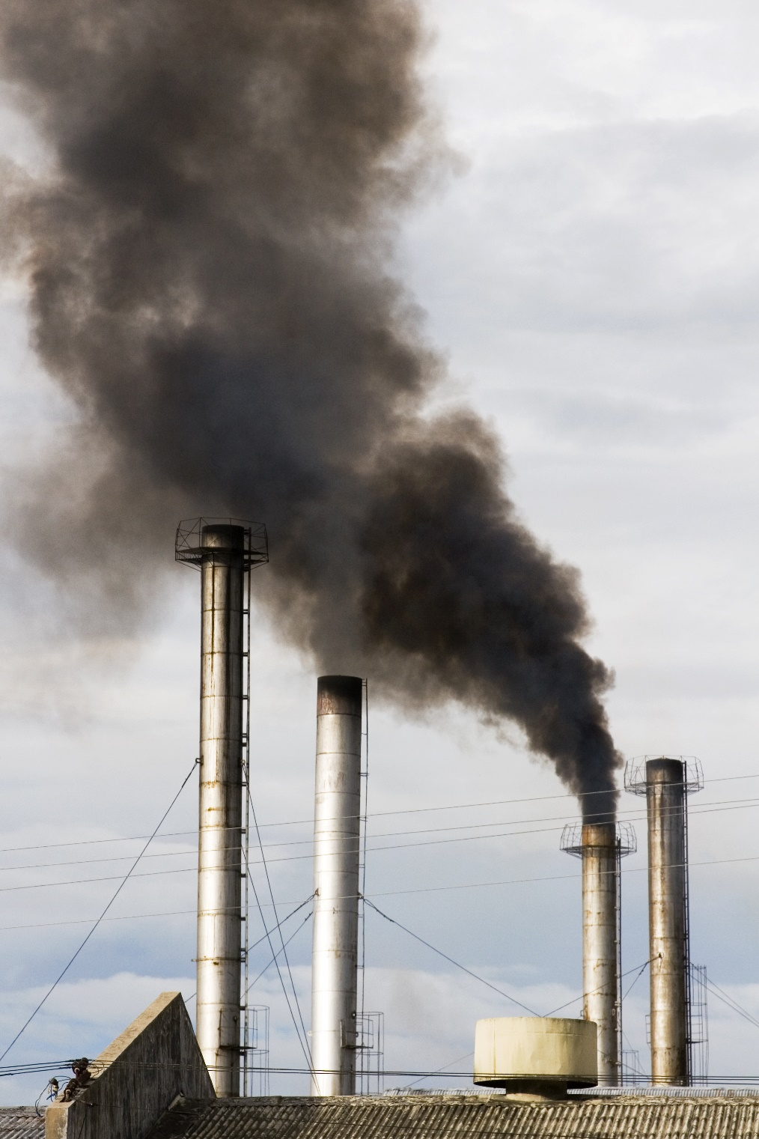
Table of Content
Introduction
Specification and Perquisites
Goals and Objectives
Implementation
Data loaded into BigInsights
Create Hive table
Visualization
Difficulties Faced
Conclusion
Links and References

Slide 3
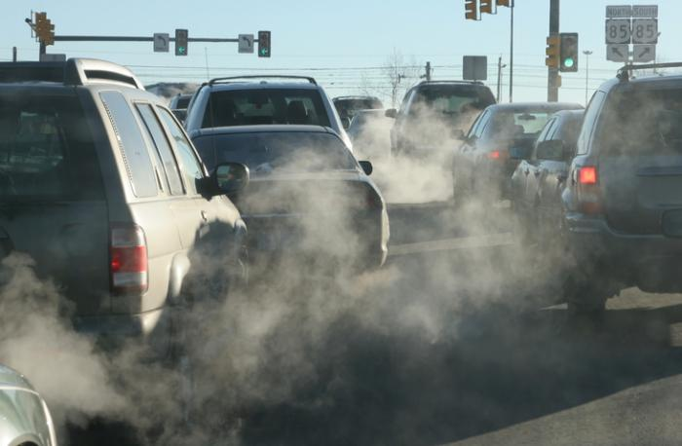
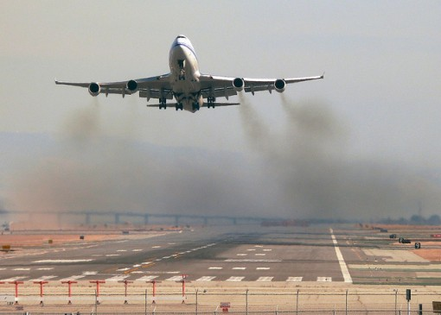
Introduction
Air pollution is a serious problem in the world right now.
Hazardous air pollutants/toxic air pollutants/air toxics are poisonous for human body.
Cause serious health problems
This data set is from the Environmental Protection Agency (EPA) tracking 187 air pollutants from 1990 to 2017.
Daily summary file, containing data for every monitor in the EPA database.

Slide 4
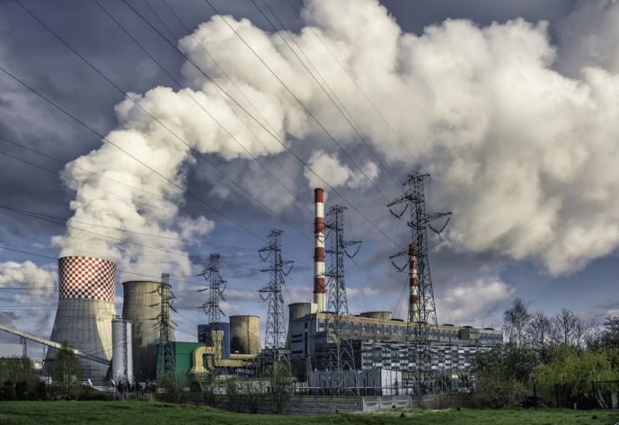
Specification and Perquisites for Hazardous Air Pollutants Dataset
Dataset: https://www.kaggle.com/epa/hazardous-air-pollutants
Dataset size: 2.29GB
Number of files: 1 File
File format: CSV file
Cluster version: IOP 4.2
Cluster number of nodes: 1 node
Operating system: Windows 10
Memory: 8 GB
CPU: 4 Cores

Slide 5
Goals
Analyze data to determine which air pollutants are measured the most
Analyze data to determine which cities have the highest and lowest air pollutants measured
Analyze data to determine which states have the highest and lowest air pollutants measured
Analyze data to determine which dates have the highest and lowest air pollutants measured

Slide 6
Objectives
Our objective for doing this project is to express the amount of air pollution caused from these last 27 years from 1990 to 2017.
By doing this analysis, we found out the most hazardous pollutants by cities and states in the U.S individually.

Slide 7




Implementation
Raw data from Kaggle.com
Stored onto HDFS
Analysis on Hive
Reporting on Tableau

Slide 8
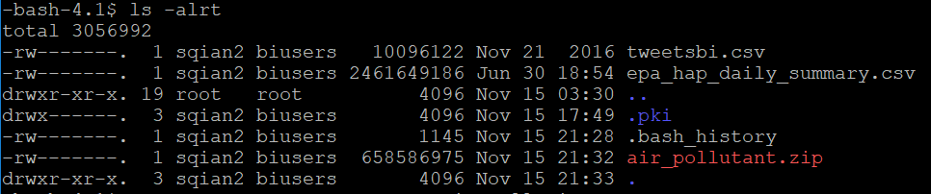
Air Pollutants Data Loaded into BigInsights
Create account on Google drive, and upload zip file
Download file on HDFS, and unzip

Slide 9
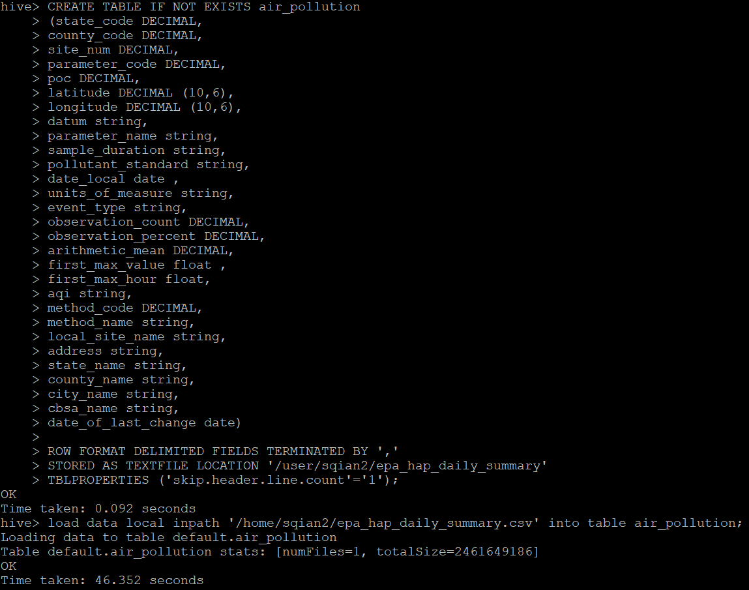
Create Hive table to Query Air Pollutants Data
CREATE TABLE IF NOT EXISTS air_pollution (state_code DECIMAL, county_code DECIMAL, site_num DECIMAL, parameter_code DECIMAL, poc DECIMAL, latitude DECIMAL (10,6), longitude DECIMAL (10,6), datum string, parameter_name string, sample_duration string, pollutant_standard string, date_local date, units_of_measure string, event_type string, observation_count DECIMAL, observation_percent DECIMAL, arithmetic_mean DECIMAL, first_max_value float, first_max_hour float, aqi string, method_code DECIMAL, method_name string, local_site_name string, address string, state_name string, county_name string, city_name string, cbsa_name string, date_of_last_change date) ROW FORMAT DELIMITED FIELDS TERMINATED BY ',' STORED AS TEXTFILE LOCATION '/user/sqian2/epa_hap_daily_summary‘ TBLPROPERTIES ('skip.header.line.count'='1');
load data local inpath '/home/sqian2/epa_hap_daily_summary.csv' into table air_pollution;

Slide 10
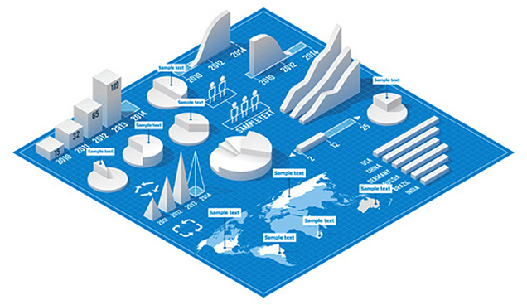
Visualization

Slide 11
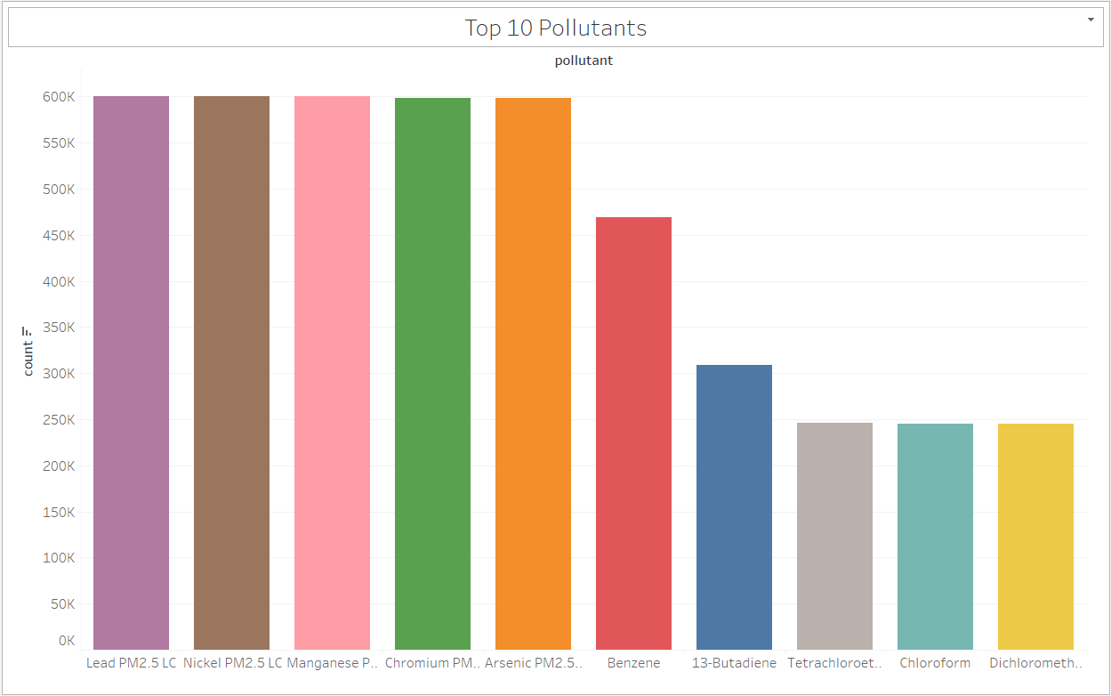
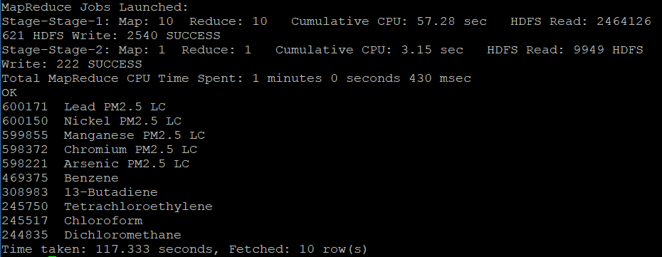
1. Top 10 Pollutants
Query to find which 10 pollutants have appeared the most

Slide 12
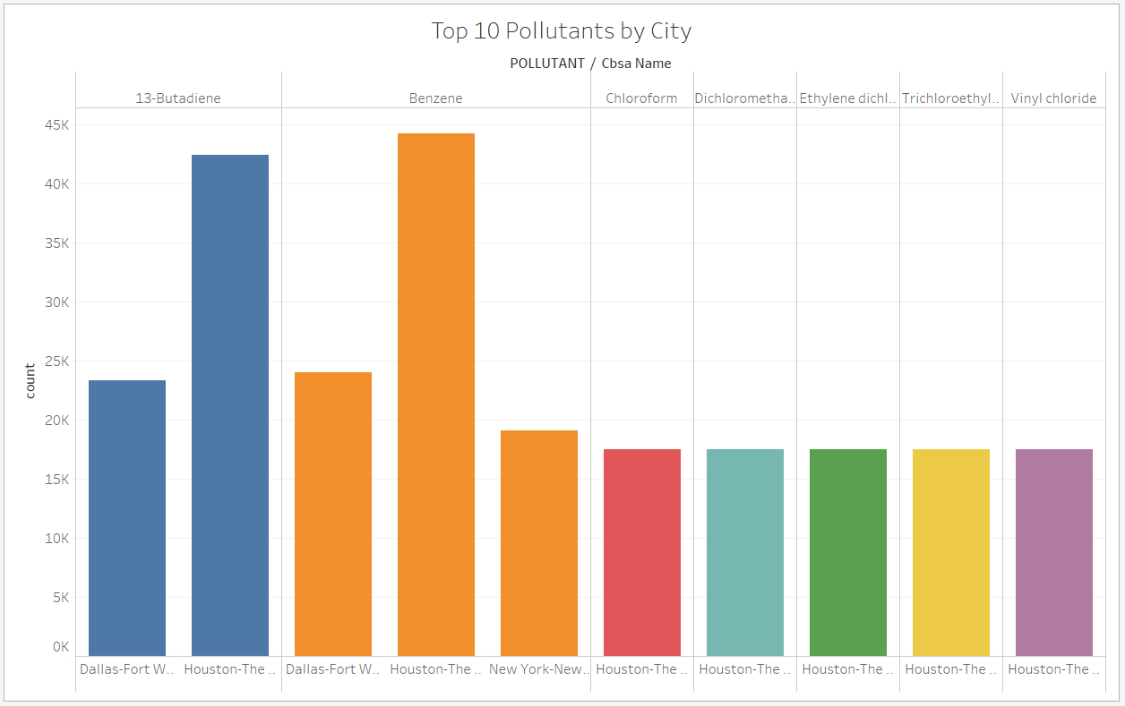
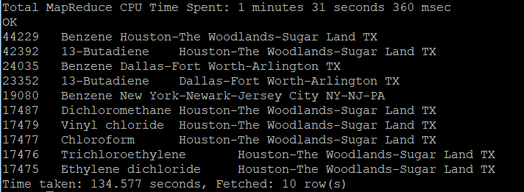
2. Top 10 Pollutants by City
Query to find which 10 pollutants have appeared the most by city

Slide 13
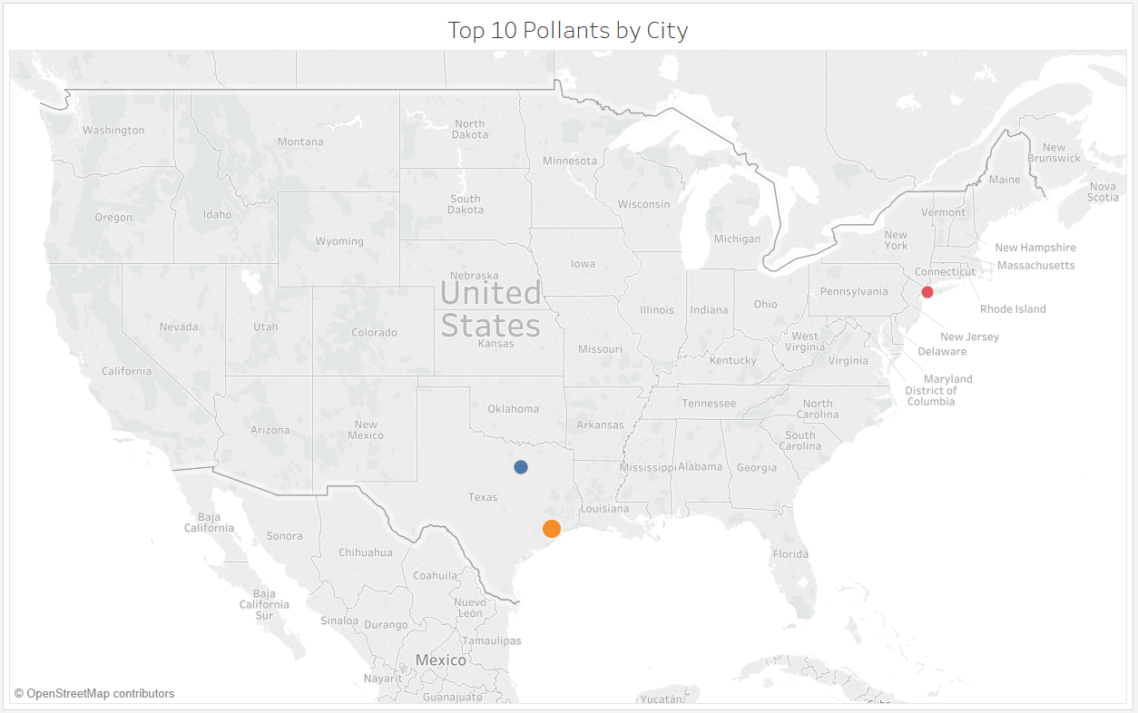

Slide 14
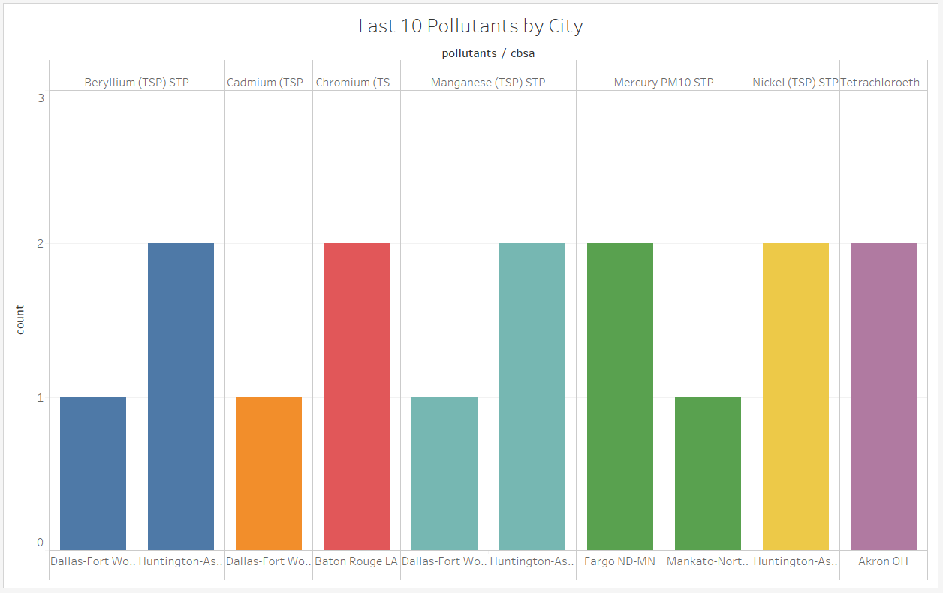
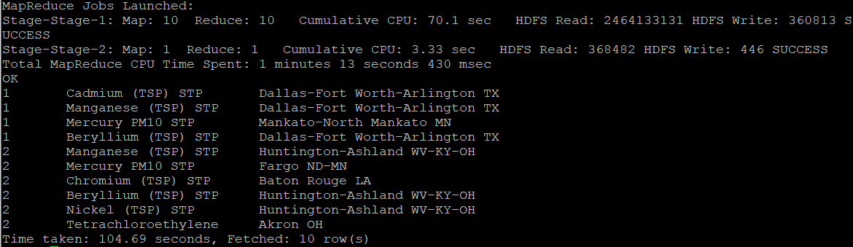
3. Last 10 Pollutants by City
Query to find which 10 pollutants have appeared the least by city

Slide 15
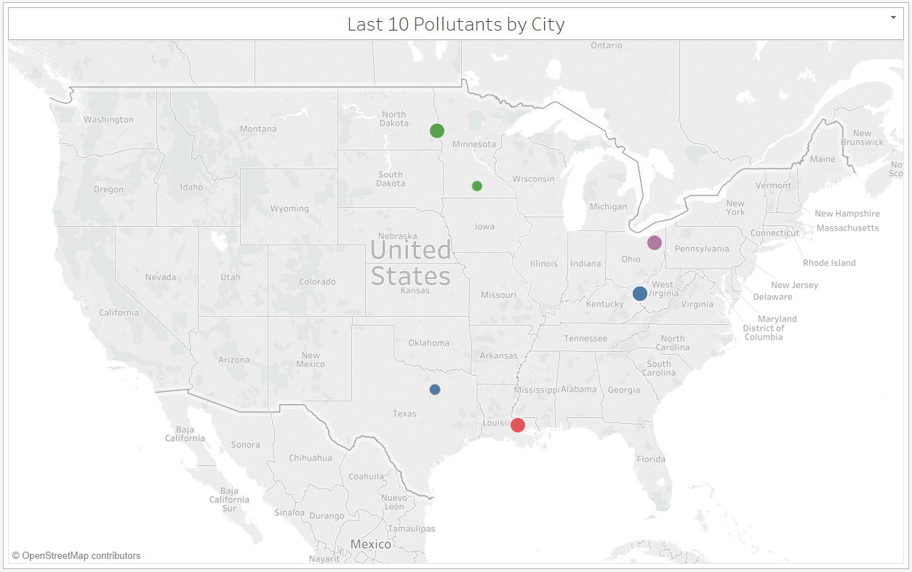

Slide 16
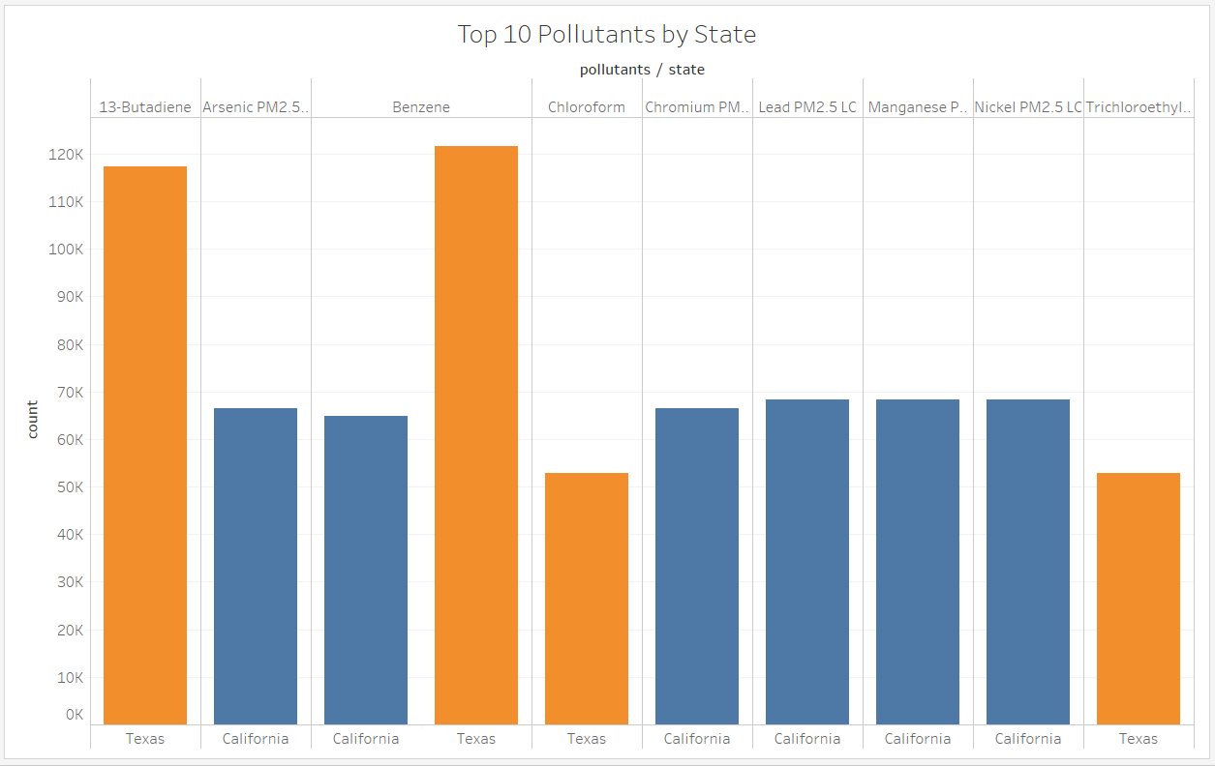
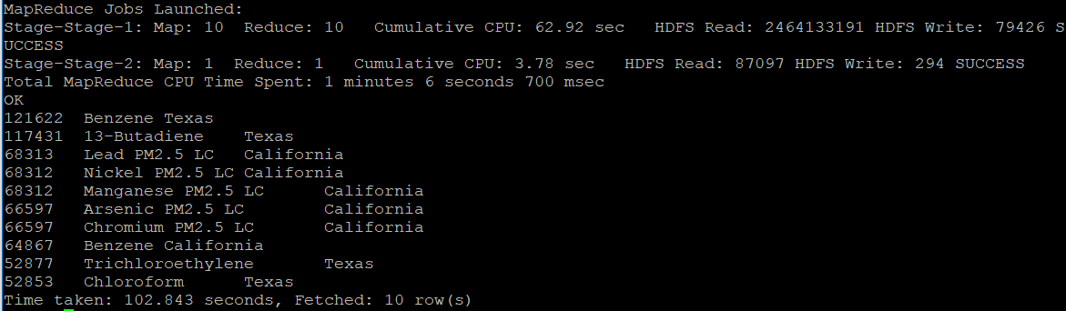
4. Top 10 Pollutants by State
Query to find which 10 pollutants have appeared the most by state

Slide 17
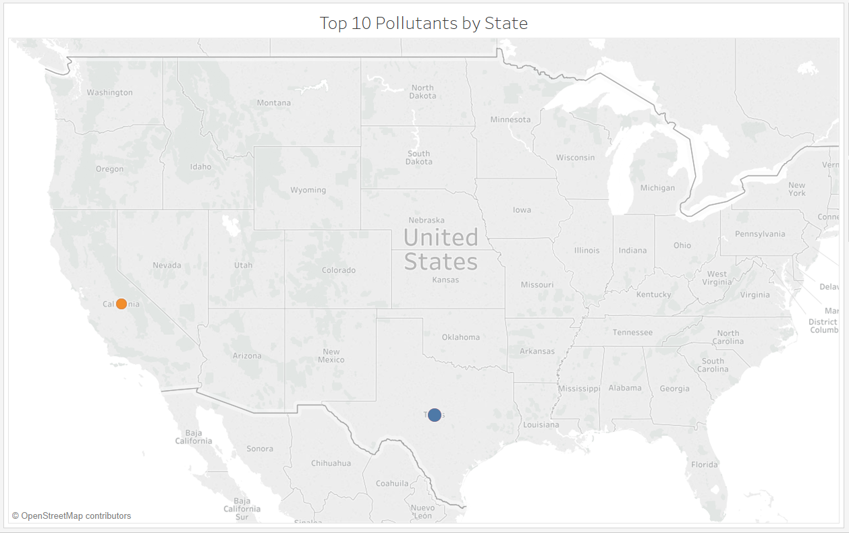

Slide 18
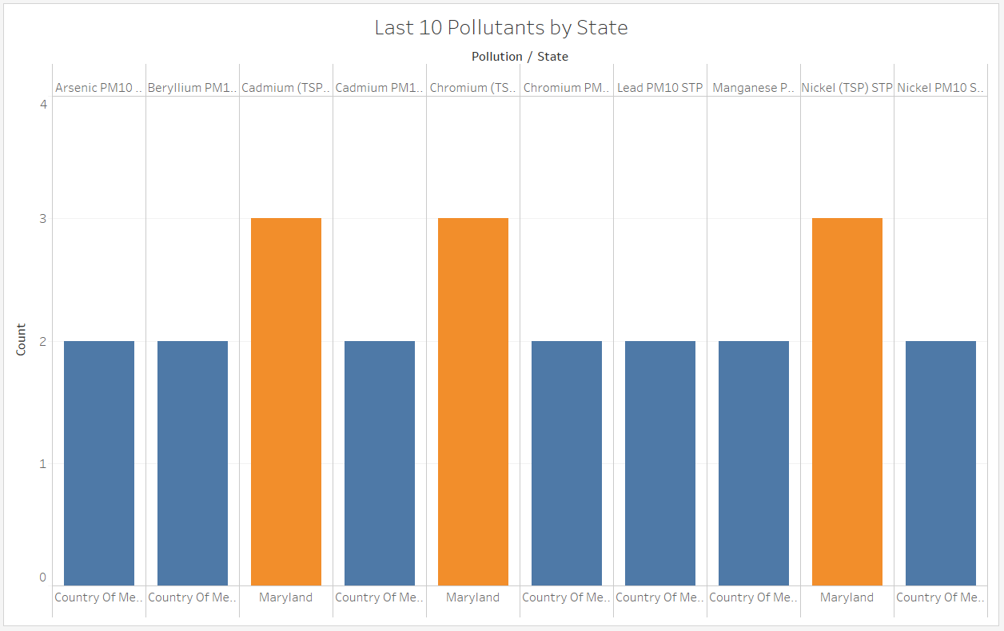
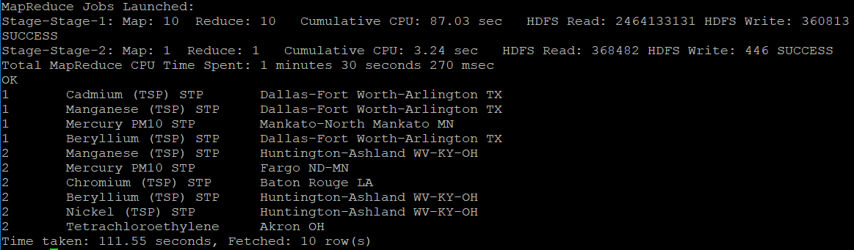
5. Last 10 Pollutants by State
Query to find which 10 pollutants have appeared the least by state

Slide 19
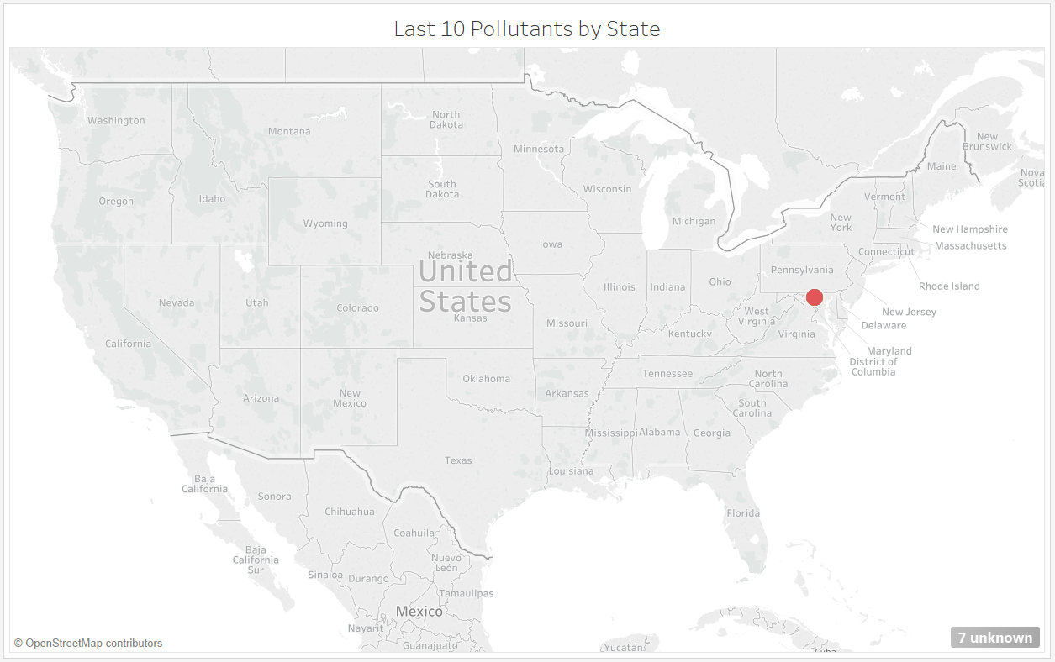

Slide 20
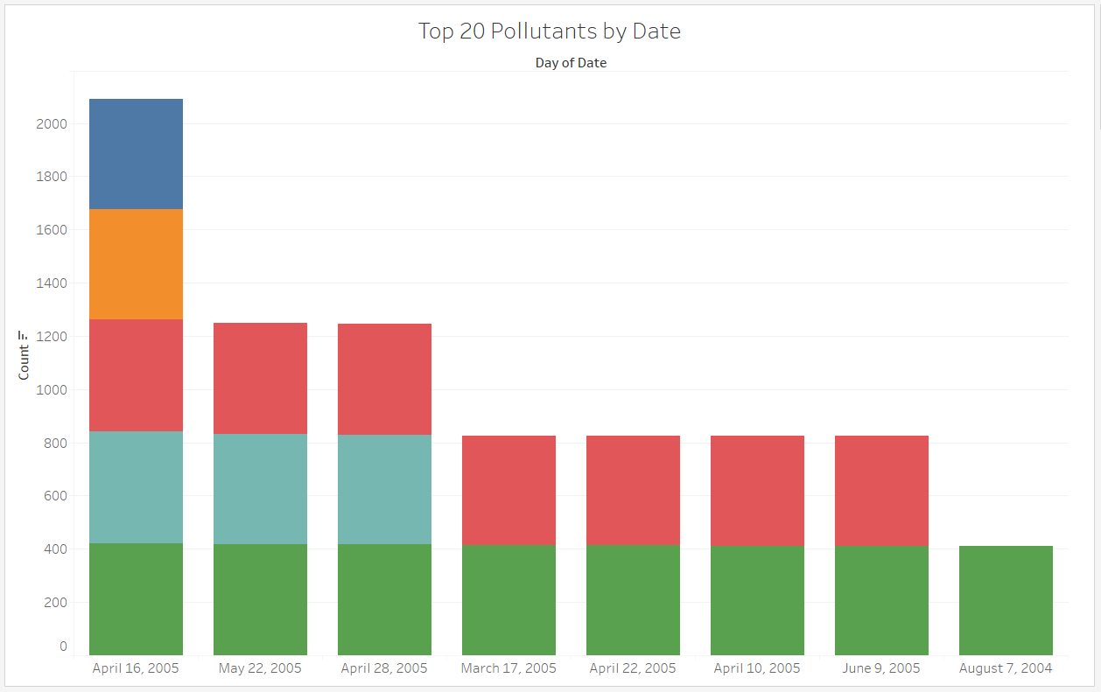
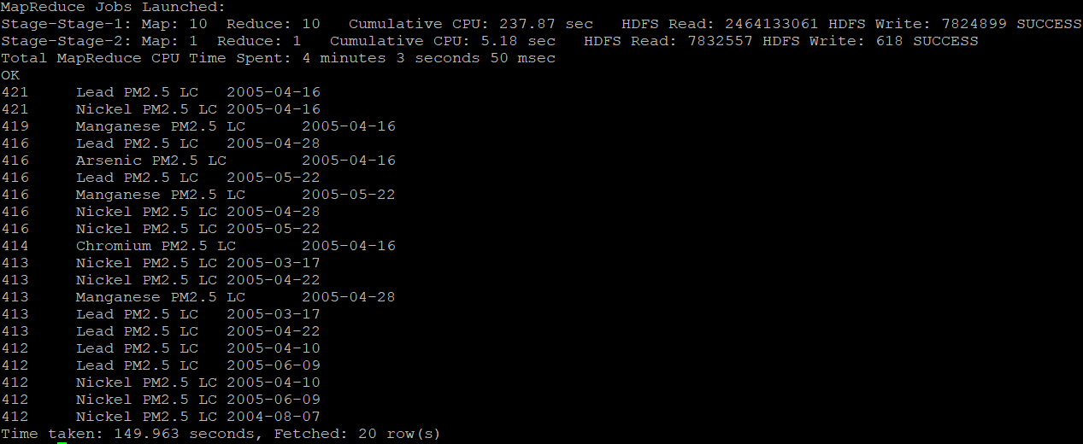
6. Top 20 Pollutants by Date
Query to find which 20 pollutants have appeared the most by date

Slide 21
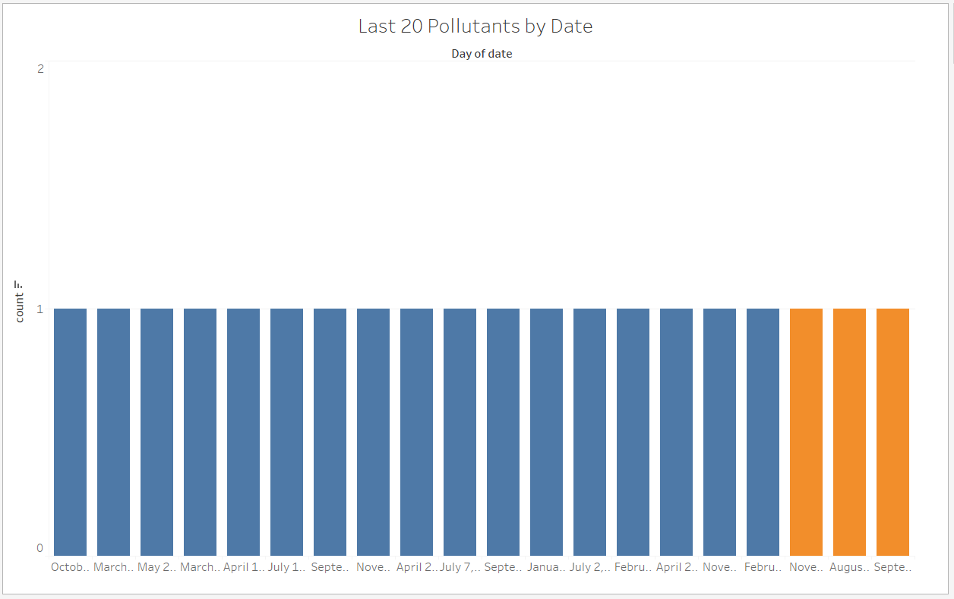
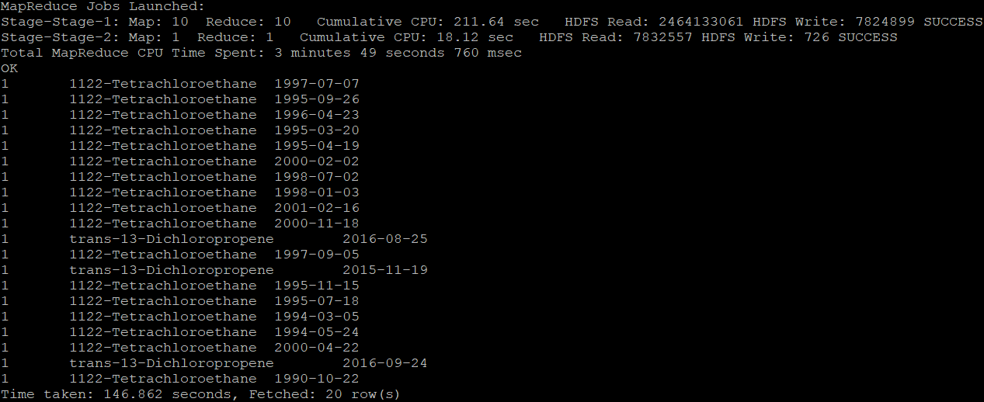
7. Last 20 Pollutants by Date
Query to find which 20 pollutants have appeared the least by date

Slide 22
Difficulties we faced
While uploading data manually into Ambari, we were not able to see the data fields in the terminal. We have overcame this difficulty by generating the link through google drive of the dataset.
While creating the table, we had difficulty by setting the decimal as a datatype for the longitude and latitude field, then after we set the parameter for the decimal data type and guess what we were able to see the co-ordinates as it is mentioned in the raw data.
We used Tableau for visualization rather than MS Excel because we were able to generate separate representation.

Slide 23

Conclusion
Air Pollutants across the United States between 1990 till 2017 was analyzed based on several aspects and documented accordingly in Hive using IBM BlueInsights.
Geo Maps and Various Chart representations were included for a better understanding of the Dataset.
GitHub:

Slide 24
Links and References
Dataset: https://www.kaggle.com/epa/hazardous-air-pollutants
GitHub:
CIS 5200 Lab – Hive Twitter Sentiment Data Analysis using BigInsights of Bluemix https://app.box.com/file/96513790564
CIS 5200 Lab – Analyzing social media and customer sentiment with IBM analytics engine and Tableau https://app.box.com/file/247447839736
Hive SQL Syntax Checker https://sql.treasuredata.com/

Slide 25
Thank You

